Slide 1

ECE 281 Lesson 16
1

Slide 2
Lesson 16 Outline
Do Time Logs!
Homework #2 (LSN 15/16 Worksheet) Due LSN 17 (next time)
Lab #2 Prelab Due LSN 19
A little Review
Finite State Machines – FSMs
FSM Analysis

Slide 3
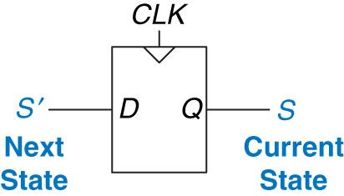
Review: Flip-Flops
From last time: What do F/Fs create?
Memory!
When do F/Fs this?
Clock Edge!
Figure 3.20 Flip-flop current state and next state
Copyright © 2013 Elsevier Inc. All rights reserved.

Slide 4
Finite State Machines - Moore vs Mealy Machine
Moore Machine – outputs depend only on current state of the machine.
Mealy Machine – outputs depend on both the current state and current inputs of the machine.
Clock
Next
State
Current
State
Inputs
M
Combinational Logic or
Next State Logic
K
Flip Flops
K
Output Logic
N
Outputs
Clock
Next
State
Current
State
Inputs
M
Combinational Logic or
Next State Logic
K
Flip Flops
K
Output Logic
N
Outputs

Slide 5
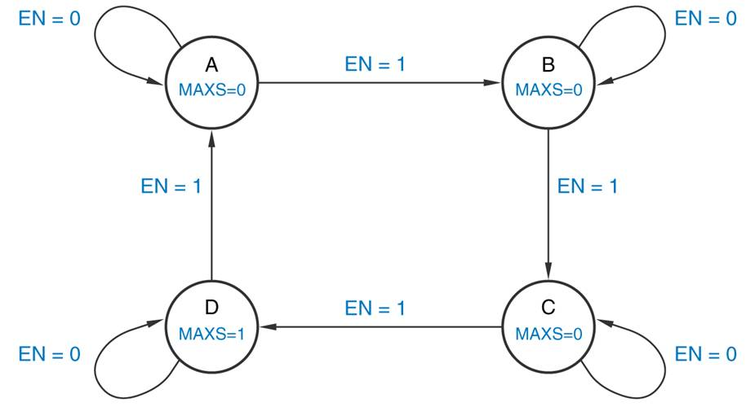
Question 1
True/False The state transition diagram below represents a Moore machine.

Slide 6
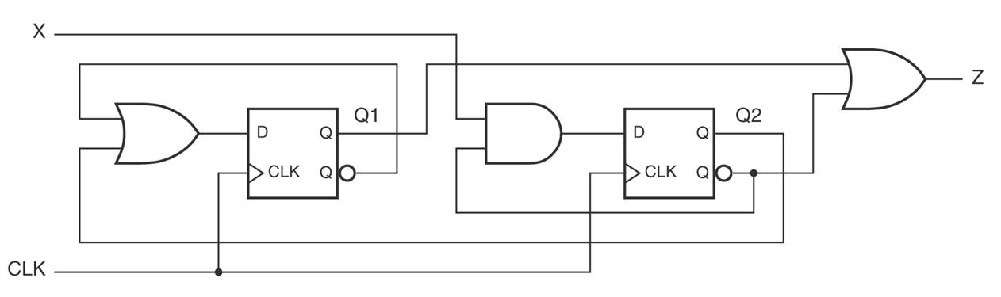
Questions 2 & 3
Is the finite state machine below a Mealy or Moore machine?
What is the next state equation for D1?
D1
D2

Slide 7
Question 4
For the finite state machine below, if the state machine is in state S2 and the input EN is a '1' when the clock transitions from low to high, what will be the machine's next state and output?
Current State S | Input EN | Next State S’ | Output Y
S0 | 0 | S0 | 0
S0 | 1 | S1 | 0
S1 | 0 | S0 | 1
S1 | 1 | S2 | 1
S2 | 0 | S3 | 1
S2 | 1 | S2 | 0
S3 | 0 | S0 | 0
S3 | 1 | S1 | 1

Slide 8
Questions 5 & 6 & 7
True/False The steps for designing a clocked synchronous state machine, starting from a word description, are just about the reverse of the analysis steps.
If a state machine requires 5 states to implement the problem, how many D flip-flops are needed (assume binary encoding)?
If a state machine requires 5 states to implement the problem, how many total states will exist in the final circuit?

Slide 9
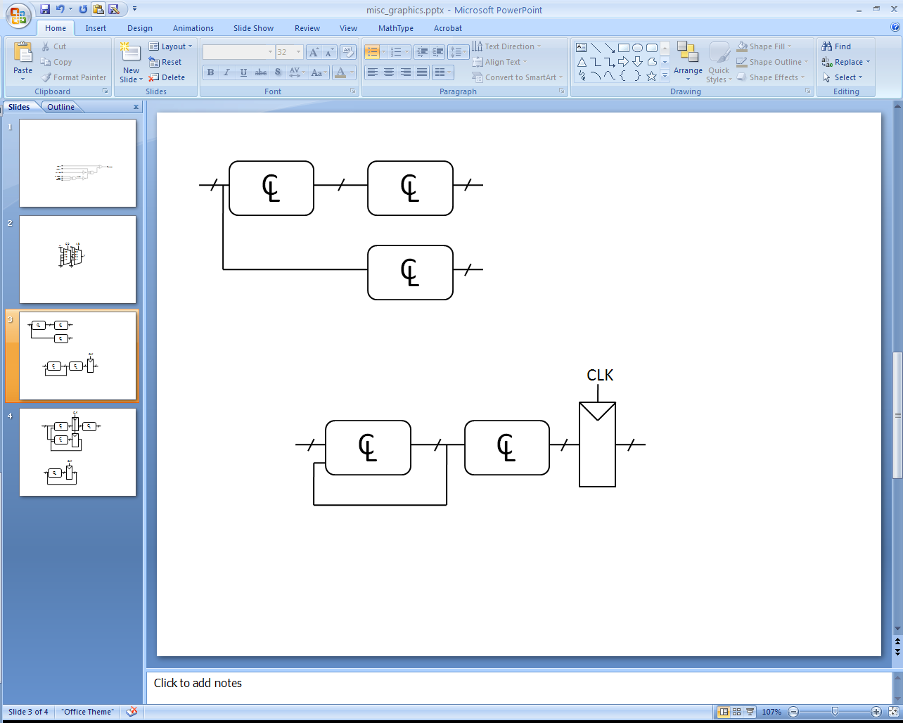
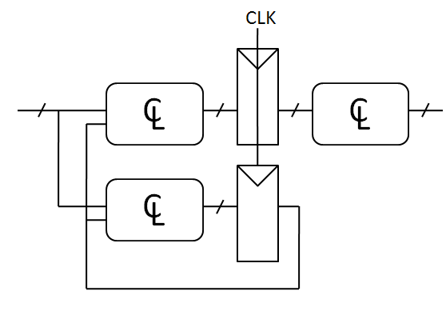
Question 8
Which of these circuits is a valid synchronous sequential circuit?
Synchronous Sequential Circuit Properties:
Each element is either a register or a combinational circuit
At least one circuit is a register
All registers have the same clock
Every cyclic path contains at least one register

Slide 10
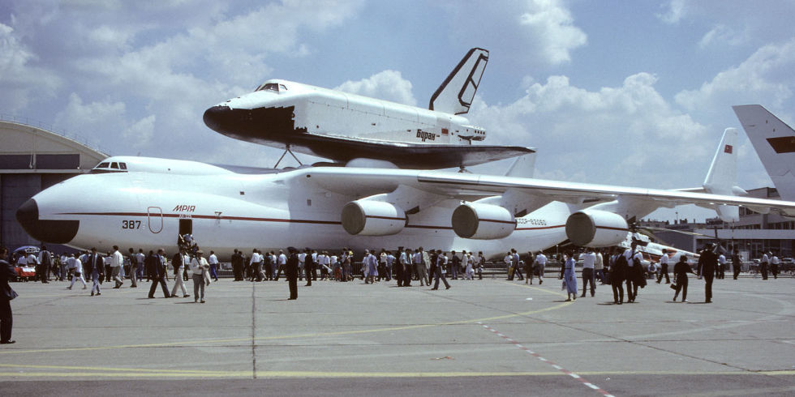
Reverse Engineering

Slide 11
Finite State Machines – Design/Analysis
State Machines:
0) Description
1) State Transition Diagram
2) State Transition Table & Output Table
3) Next State and Output State Equations
4) Schematic
Design
Analysis
Copyright © 2013 Elsevier Inc. All rights reserved.

Slide 12
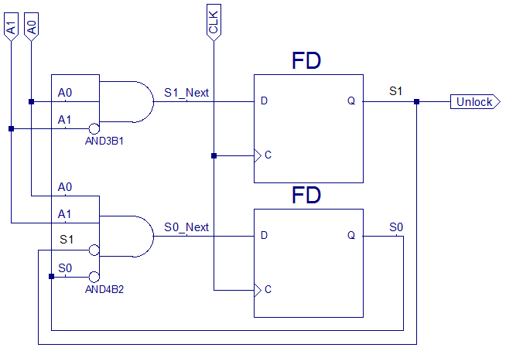
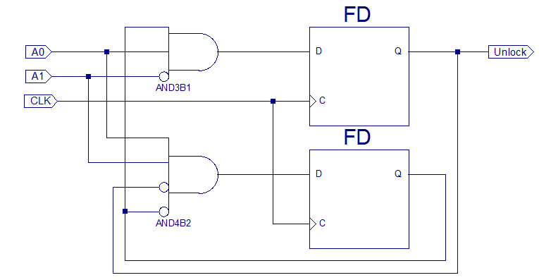
Finite State Machines – Analysis Joe Homeowner’s Garage Door Opener
Joe Homeowner’s Gargage Door Opener…we are given the schematic
S0
A0
S1*
S1
MSB
A1
CLK
A0
A1
S0*
S0
S1
LSB
S0
CLK
Copyright © 2013 Elsevier Inc. All rights reserved.

Slide 13
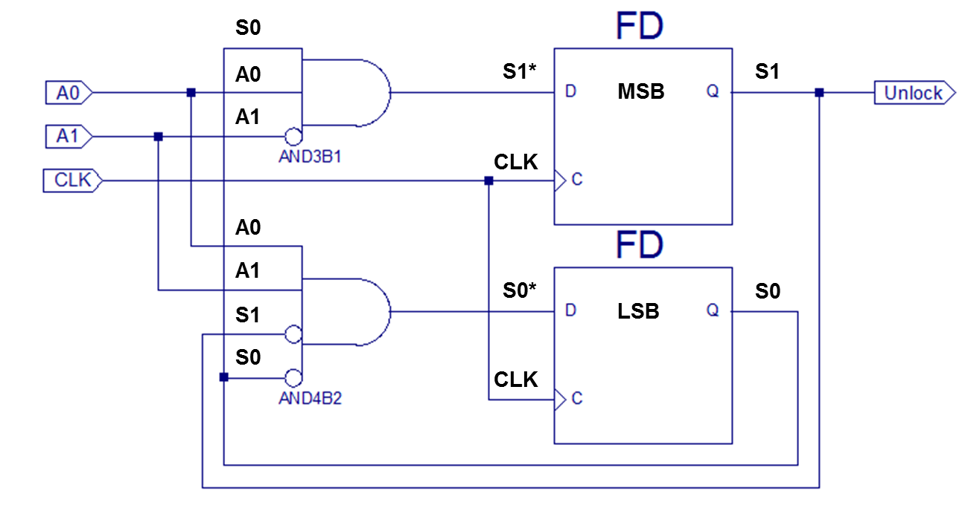
Finite State Machines – Analysis Joe Homeowner’s Garage Door Opener
Step 2) State Transition Table & Output Table
Next State Table:
Current State |  | Inputs |  | Next State |  | Next State Name
S₁ | S₀ | A₁ | A₀ | S₁* | S₀*
0 | 0 | 0 | 0
0 | 0 | 0 | 1
0 | 0 | 1 | 0
0 | 0 | 1 | 1
0 | 1 | 0 | 0
0 | 1 | 0 | 1
0 | 1 | 1 | 0
0 | 1 | 1 | 1
1 | 0 | 0 | 0
1 | 0 | 0 | 1
1 | 0 | 1 | 0
1 | 0 | 1 | 1
1 | 1 | 0 | 0
1 | 1 | 0 | 1
1 | 1 | 1 | 0
1 | 1 | 1 | 1
Step 4) Schematic
Output Table
Current State |  | Output | State Name
S₁ | S₀ | Unlock

Slide 14
Finite State Machines – Analysis Joe Homeowner’s Garage Door Opener
Step 2) State Transition Table & Output Table
Step 1) State Transition Diagram
Next State Table:
Current State |  | Inputs |  | Next State |  | Next State Name
S₁ | S₀ | A₁ | A₀ | S₁* | S₀*
0 | 0 | 0 | 0 | 0 | 0 | M₀
0 | 0 | 0 | 1 | 0 | 0 | M₀
0 | 0 | 1 | 0 | 0 | 0 | M₀
0 | 0 | 1 | 1 | 0 | 1 | M₁
0 | 1 | 0 | 0 | 0 | 0 | M₀
0 | 1 | 0 | 1 | 1 | 0 | M₂
0 | 1 | 1 | 0 | 0 | 0 | M₀
0 | 1 | 1 | 1 | 0 | 0 | M₀
1 | 0 | 0 | 0 | 0 | 0 | M₀
1 | 0 | 0 | 1 | 0 | 0 | M₀
1 | 0 | 1 | 0 | 0 | 0 | M₀
1 | 0 | 1 | 1 | 0 | 0 | M₀
1 | 1 | 0 | 0 | 0 | 0 | N/A
1 | 1 | 0 | 1 | 1 | 0 | N/A
1 | 1 | 1 | 0 | 0 | 0 | N/A
1 | 1 | 1 | 1 | 0 | 0 | N/A
reset
M3
Unlock=1
Ghost
State
else
M0
Unlock=0
M0
any A
else
A=11(3)
M1
M2
Unlock=1
M1
Unlock=0
M2
A=01(1)
Output Table
Current State |  | Output | State Name
S₁ | S₀ | Unlock
0 | 0 | 0 | M₀
0 | 1 | 0 | M₁
1 | 0 | 1 | M₂
1 | 1 | 1 | M₃
M3 Ghost State – never gets here
Step 0) Description
What is the Door combination?

Slide 15
Finite State Machines – Analysis Joe Homeowner’s Garage Door Opener
reset
M3
Unlock=1
Ghost
State
else
M0
Unlock=0
any A
else
A=11(3)
M2
Unlock=1
M1
Unlock=0
A=01(1)

Slide 16
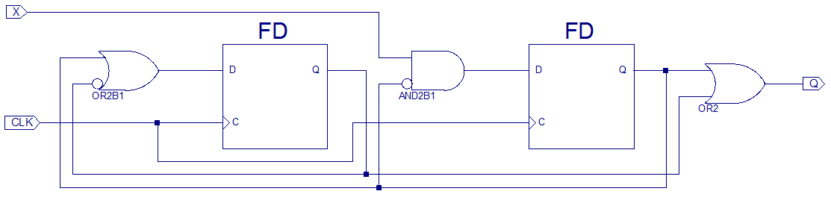
Another Analysis Example HW 3.31
HW 3.31 – Write the next state/output tables and equations. Draw the state transition diagram.
S1*
S1
S0*
S0
MSB
LSB

Slide 17
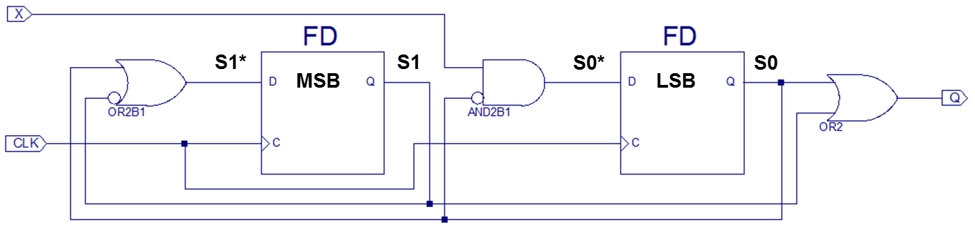
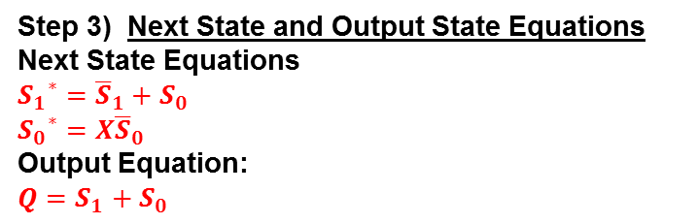
Another Analysis Example HW 3.31
Step 4) Schematic
Step 2) State Transition Table & Output Table
Next State Table:
Current State |  | Inputs | Next State |  | Next State
S₁ | S₀ | X | S₁* | S₀* | Name
M0
Step 3) Next State and Output State Equations
Next State Equations
Output Equation:
Step 3) Next State and Output State Equations
Next State Equations
${S_{1}}^{∗}={\overline{S}}_{1}+S_{0}$
${S_{0}}^{∗}=X{\overline{S}}_{0}$
Output Equation:
$Q=S_{1}+S_{0}$
M1
M2
M3
Output Table
Current State |  | Output | State Name
S₁ | S₀ | Q

Slide 18
Another Analysis Example HW 3.31
Step 2) State Transition Table & Output Table
Step 1) State Transition Diagram
Next State Table:
Current State |  | Inputs | Next State |  | Next State
S₁ | S₀ | X | S₁* | S₀* | Name
0 | 0 | 0 | 1 | 0 | M₂
0 | 0 | 1 | 1 | 1 | M₃
0 | 1 | 0 | 1 | 0 | M₂
0 | 1 | 1 | 1 | 0 | M₂
1 | 0 | 0 | 0 | 0 | M₀
1 | 0 | 1 | 0 | 1 | M₁
1 | 1 | 0 | 1 | 0 | M₂
1 | 1 | 1 | 1 | 0 | M₂
M0
Q=0
M1
Q=1
M0
X=0
M1
M2
M3
X=1
X=X
X=1
Output Table
Current State |  | Output | State Name
S₁ | S₀ | Q
0 | 0 | 0 | M₀
0 | 1 | 1 | M₁
1 | 0 | 1 | M₂
1 | 1 | 1 | M₃
X=0
M3
Q=1
M2
Q=1
X=X
Step 0) Description
This finite state machine is a divide-by-two counter (see Section 3.4.2) when X = 0. When X = 1, the output, Q, is HIGH.
Step 0) Description

Slide 19
Divide-by-N Counter – Example 3.6
Has one output and no inputs
The output Y is HIGH for one clock cycle out of every N
In other words, the output divides the frequency of the clock by N

Slide 20
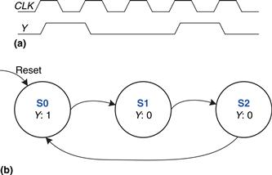
Divide-by-3 Counter – Example 3.6
The waveform and state transition diagram for a divide-by-3 counter is shown in Figure 3.28
Next State Table
Current State | Next State
S0 | S1
S1 | S2
S2 | S0
Output Table
Current State | Output
S0 | 1
S1 | 0
S2 | 0

Slide 21
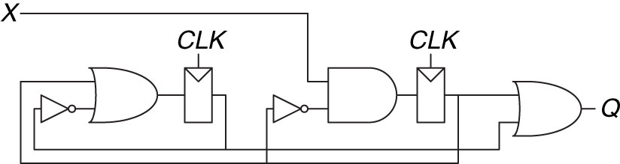
Another Analysis Example
HW 3.31 – Write the next state/output tables and equations. Draw the state transition diagram.
S1*
S1
S0*
S0

Slide 22

22

Slide 23
Question 9
State machine analysis is a process that begins with a circuit schematic and results in a state transition diagram. If given a schematic, the first step in analysis would be:
Determine the logic elements required to build the state machine
Determine the next-state and output functions implemented by the circuit
Predict the next state that the circuit will transition to

Slide 24
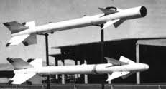

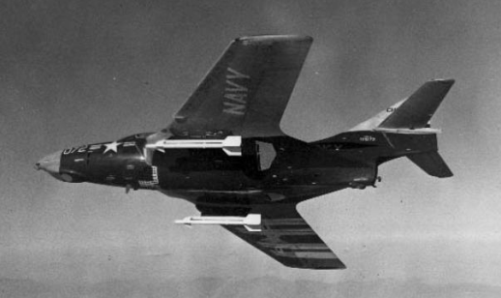
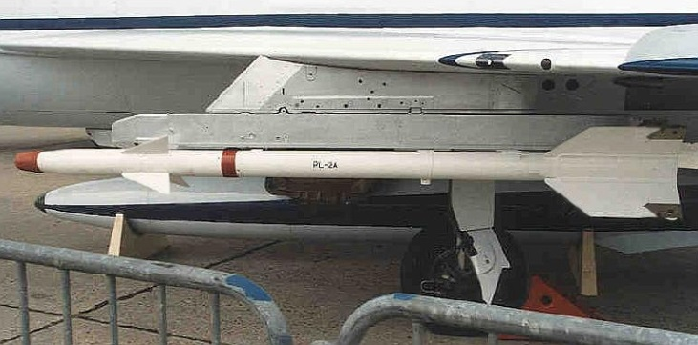
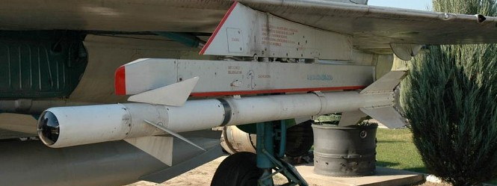
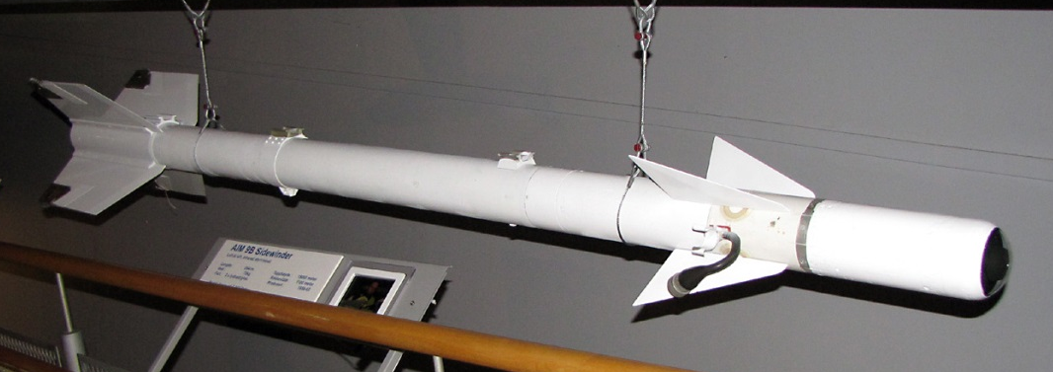
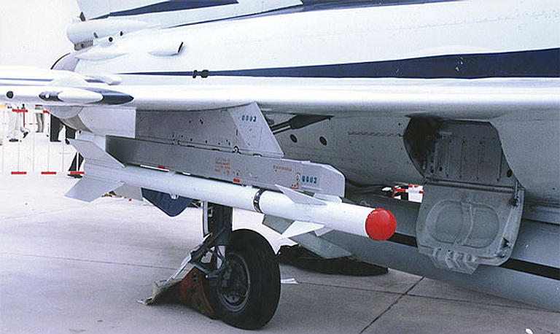
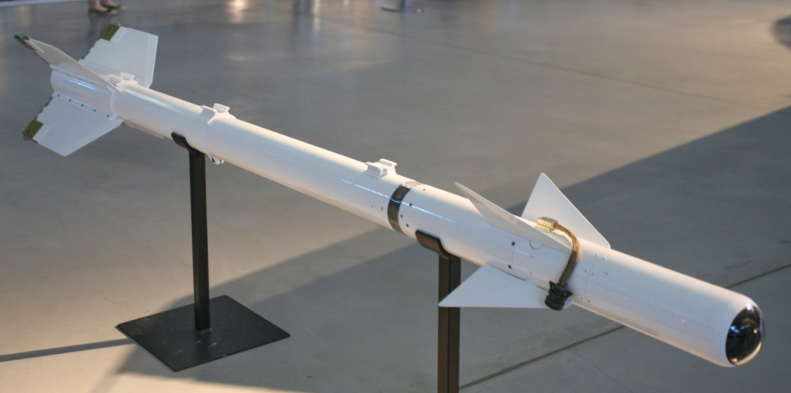
AIM-9B AA-2 (K-13)

Slide 25
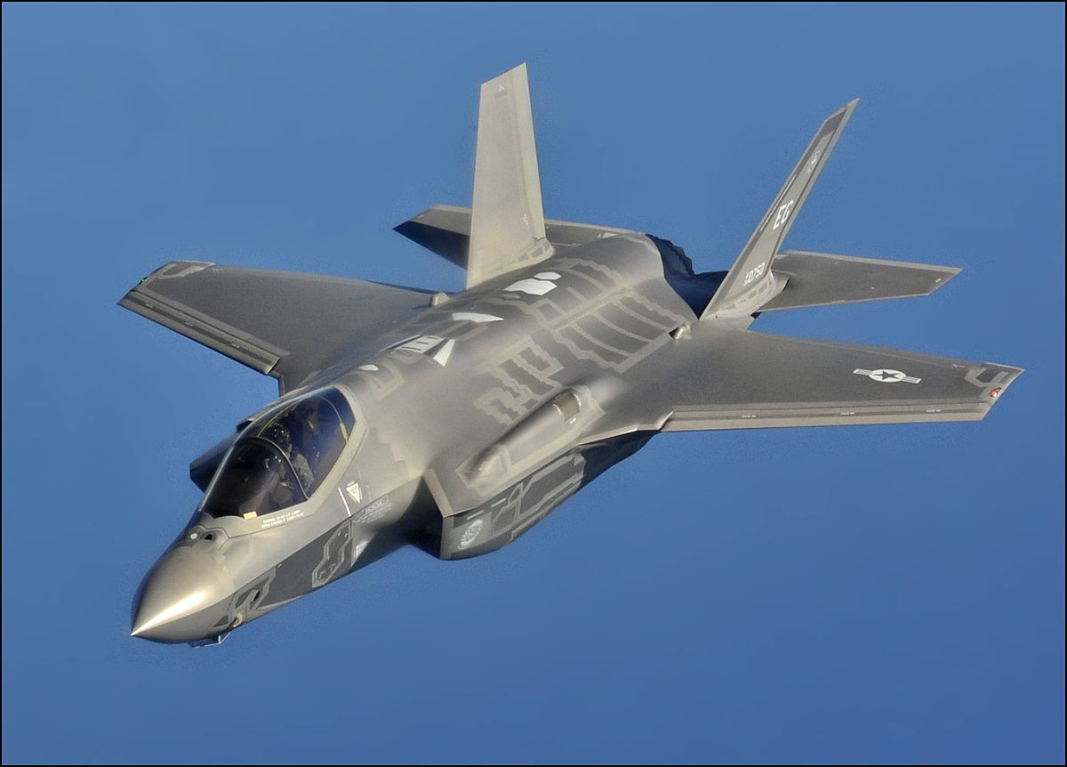

F-35 / J-31
By U.S. Air Force photo by Master Sgt. Donald R. Allen - http://www.dvidshub.net/image/935698/aerial-refueling-f-35-lightning-ii-joint-strike-fighters-eglin-afb-fla#.UZyEMrVU8QY, Public Domain, https://commons.wikimedia.org/w/index.php?curid=49689165
http://www.airliners.net/photo/Untitled-(AVIC)/Shenyang-J-31-(F60)/2542713/L/

Slide 26
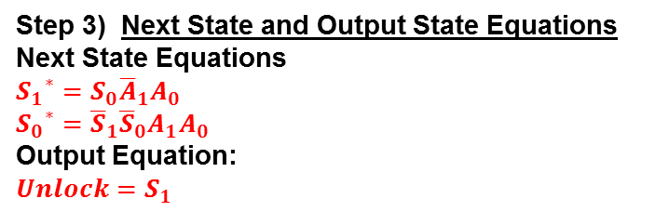
Finite State Machines – Analysis Joe Homeowner’s Garage Door Opener
Step 4) Schematic
Step 2) State Transition Table & Output Table
Next State Table:
Current State |  | Inputs |  | Next State |  | Next State Name
S₁ | S₀ | A₁ | A₀ | S₁* | S₀*
Step 3) Next State and Output State Equations
Next State Equations
Output Equation:
Step 3) Next State and Output State Equations
Next State Equations
${S_{1}}^{∗}=S_{0}{\overline{A}}_{1}A_{0}$
${S_{0}}^{∗}={\overline{S}}_{1}{\overline{S}}_{0}A_{1}A_{0}$
Output Equation:
$Unlock=S_{1}$
Output Table
Current State |  | Output | State Name
S₁ | S₀ | Unlock

Slide 27
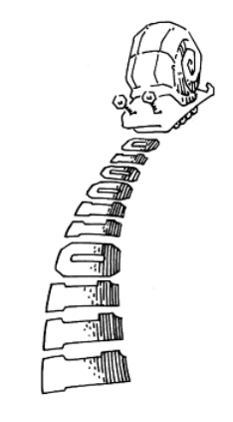
In-Class Exercise
Draw me a picture of a Mealy or Moore State Transition Diagram that shows
A Snail is crawling across a sequence of numbers and he smiles if the last 2 numbers are “11”
Sequence: 0100110111

Slide 28
In-Class Exercise – One Moore Solution
A Snail is crawling across a sequence of numbers and he smiles if the last 2 numbers are “11”
Sequence: 0100110111
N=0
N=1
reset
S0
☺=0
S1
☺=0
N=0
N=1
N=0
S3
☺=1
N=1

Slide 29
Homework – Review Book Example
Take a look at how the book implements “01”
Example 3.7 on p 132
A Snail is crawling across a sequence of numbers and he smiles if the last 2 numbers are “01”
Sequence: 0100110111

Slide 30
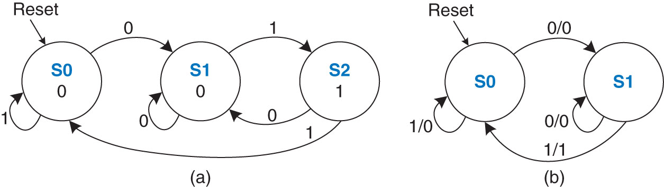
Homework – Review Book Example
Example 3.7 on p 132
A Snail is crawling across a sequence of numbers and he smiles if the last 2 numbers are “01”
Sequence: 0100110111
Figure 3.30 FSM state transition diagrams: (a) Moore machine, (b) Mealy machine
Copyright © 2013 Elsevier Inc. All rights reserved.

